Slide 1
Tray id Detection
Duong, Van Binh
Tran, Phong Thach
Luong, Xuan Dong
Truong, Quang Trong
Le, Van Cung
SAW, ASSEMBLY ENGINEERING

Slide 2
TRAY ID DETECTION
MODULE : SAW SINGULATION

Slide 3
1. Define Problem
Factory/ Module | VNAT/SAW
Process | Strip singulation
Start Date | Sep, 02 2019
Comp. Date | TBD
Leader | Duong, Van Binh
Mentor | Nguyen, Sy Hung
Team Members | Duong, Van Binh Tran, Phong Thach Luong, Xuan Dong Truong, Quang Trong Le, Van Cung
Objective | Improve the SAW Machine availability
Problem / Issue: Serval Yield excursions due to MT load wrong tray.
First Case: On WW 28.6D’19, lot U928D369 (JFP2 product) had 3256u OOP at SSS001 due to wrong tray usage. One bundle of THP tray (Part#500298820) were loaded into tool instead of JFP2 (Part#500298821) tray
Second Case: On WW 30.2N, SSS006 was planned to convert from XG756 to XG766. MT did a mistake to keep loading XG756 tray to tool after conversion. This cause unit OOP in 5 tray (1100 units rejected).
→ In Q3’19, we have 2 cases due to wrong tray usage cause 4356 units OOP rejected.
Goal or Objective:
To eliminate the number of OOP units at SAW module due to wrong tray loading.

Slide 4
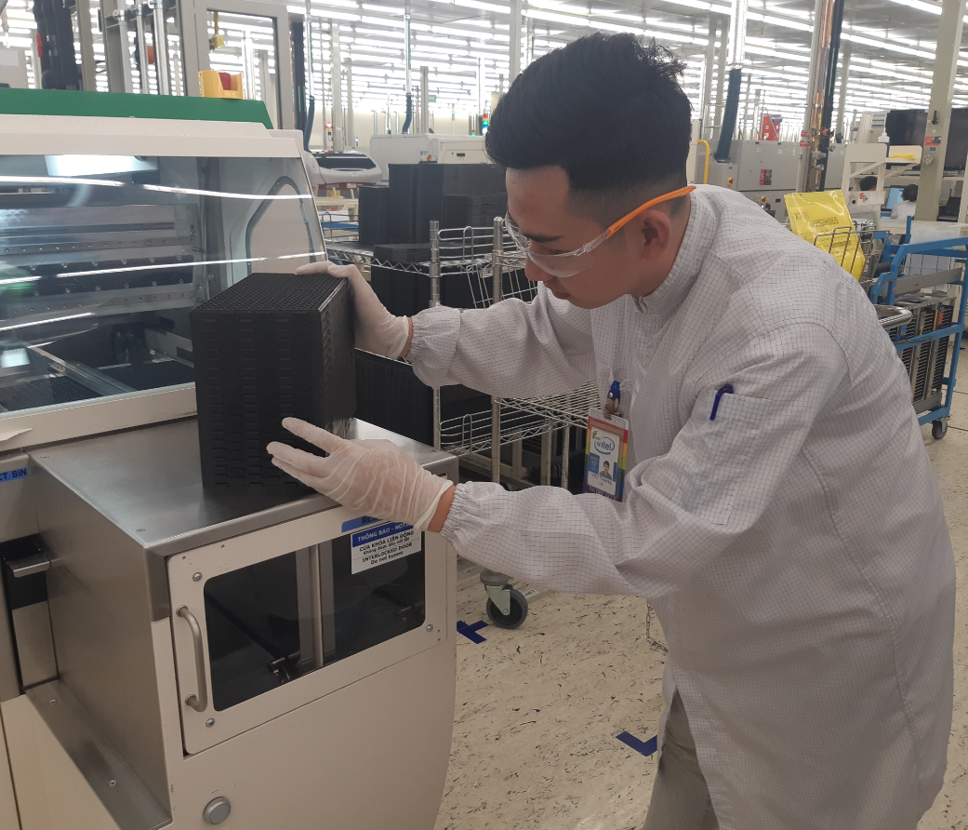
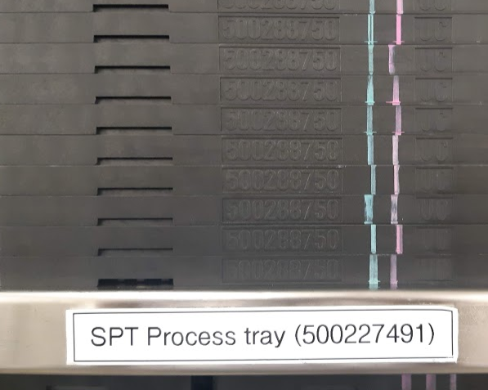
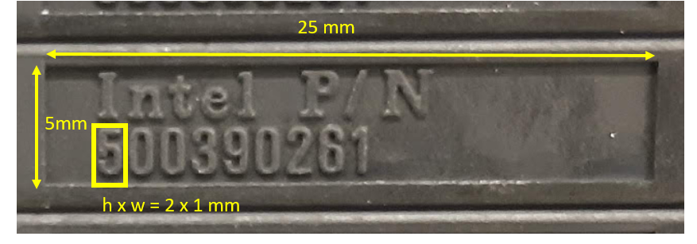
2. Current situation
Many steps to perform RTI tray ID
Mixing trays at IDM Kanban
The size of trays number is small
MTs have to do more steps to perform the visual inspection tray ID before running.
The size of tray ID is small and the surface texture is not easy to inspect.
A lots types of tray at IDM Kanban

Slide 5
3. ANALYZE CAUSES
Machine has no capability to detect the different trays.
Depending on human inspection e.t..
Inspection task is difficult with workers has astigmatism, nearsightedness, night blindness… disease.
In addition, …

Slide 6
3. ANALYZE CAUSES
5M+E | Possible Cause | Result True/False
Manpower | Depending on human. Can’t eliminate the human mistake when inspect Tray ID | TRUE
Method | Check Tray ID by human | TRUE
Mesurement | Null | FALSE
Materials | Tray ID is difficults to read | FALSE
Machine | The Saw tool is not capable to detect the tray’s ID | TRUE
Enviroment | Null | FALSE

Slide 7
4. DEVERLOP SOLUTION (Diagram of solution)

Slide 8
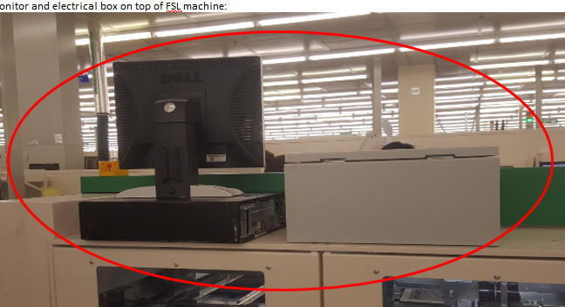
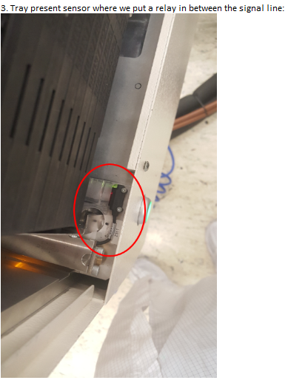
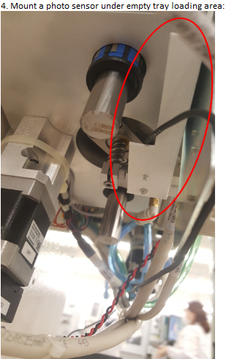
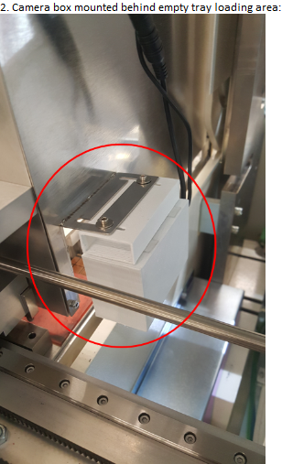
4. DEVERLOP SOLUTION (Hardware installing)

Slide 9
5. VALIDATE SOLUTION (Fishbone after apply solution)
Machine has the capability to detect the different trays after applying solution.
Eliminate the risk that depending on human inspection e.t..
In addition, …

Slide 10
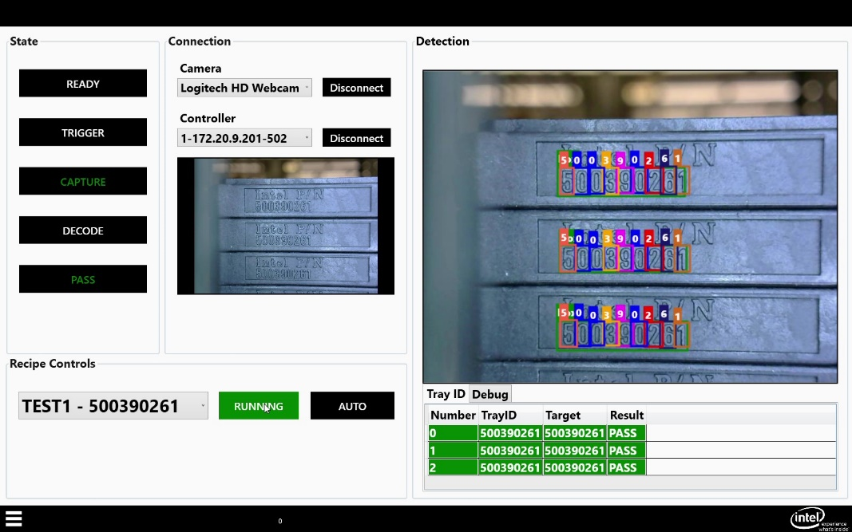
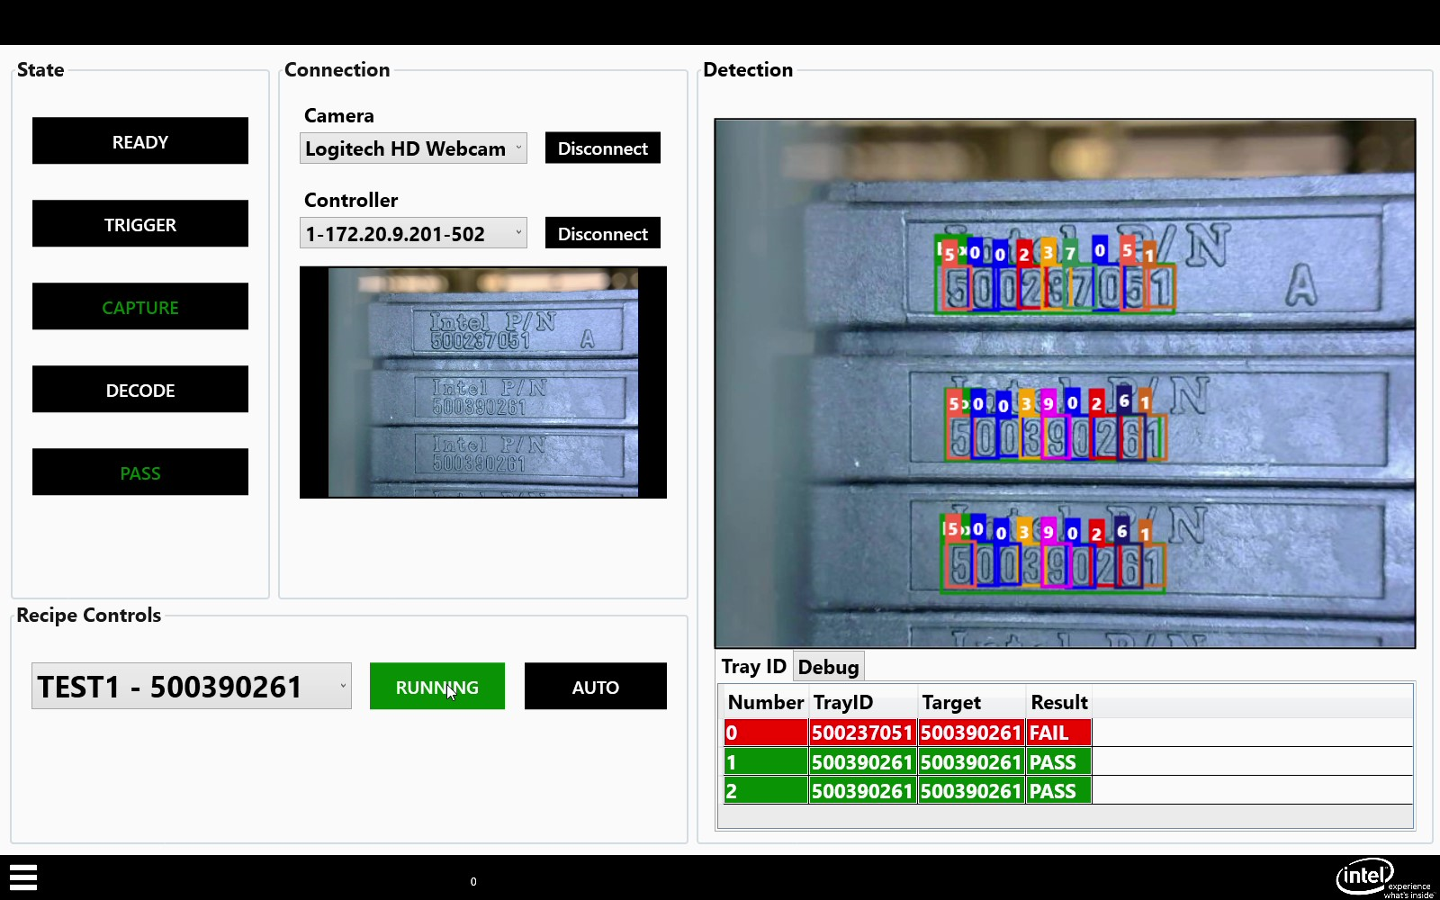
5. VALIDATE SOLUTION (Results)
All tray is pass
The result showed the tray 500237051 is detected wrong with expect 50039026.

Slide 11
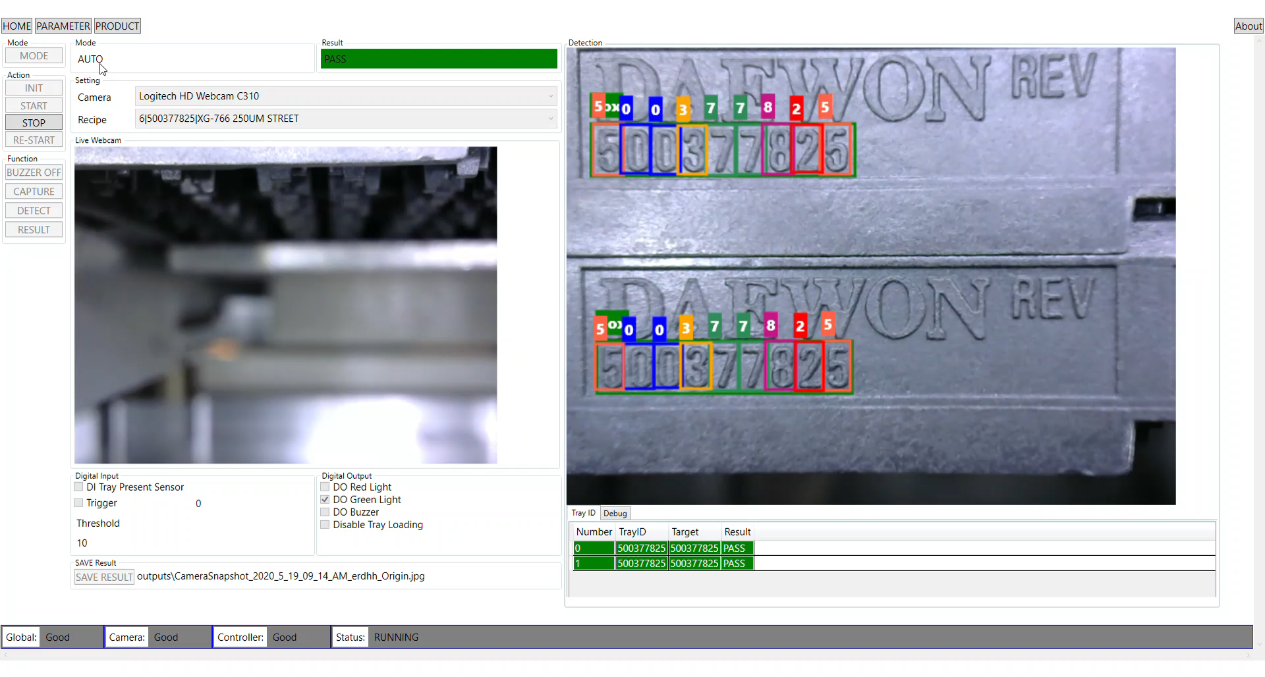
5. VALIDATE SOLUTION (Pass Tray Demo)

Slide 12
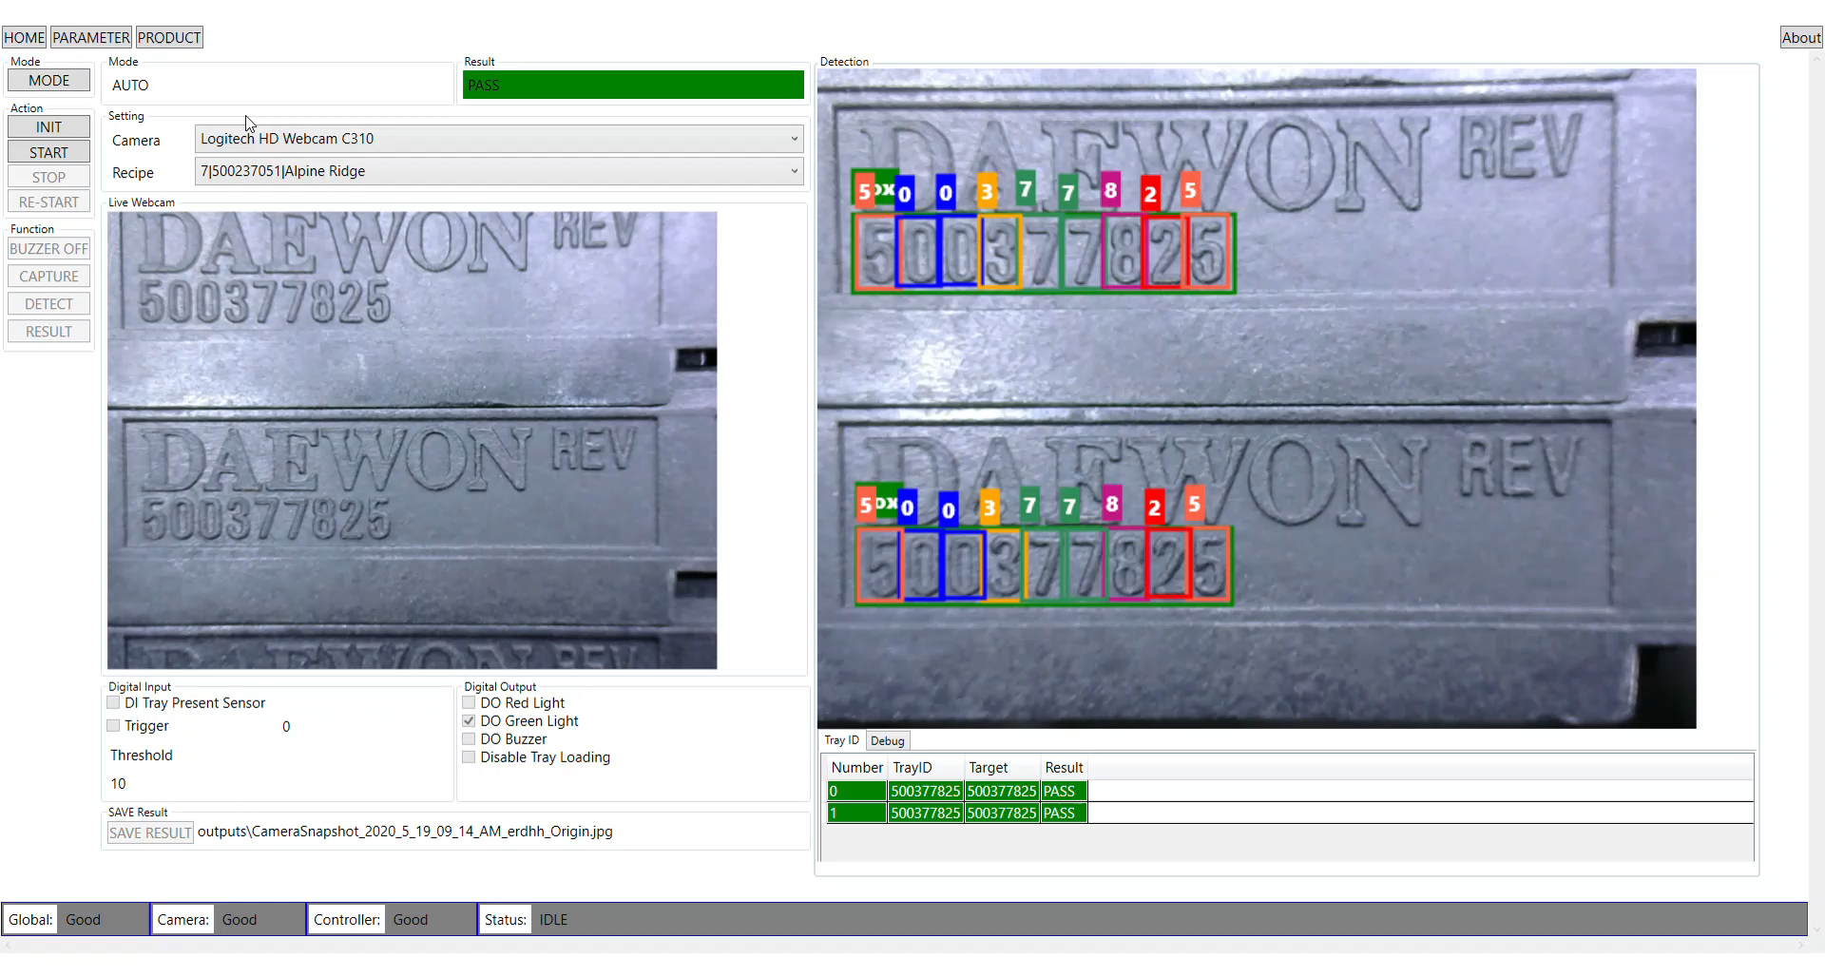
5. VALIDATE SOLUTION (Wrong Tray Demo)

Slide 13
6. STANDARDIZATION
The avoid loading wrong tray system at SAW Project
7 Step Problem Solving |  | Step |  |  |  | Oct |  |  |  |  | Nov |  |  |  | Dec |  |  |  | Jan
 |  | WW37 | WW38 | WW39 | WW40 | WW41 | WW42 | WW43 | WW44 | WW45 | WW46 | WW47 | WW48 | WW49 | WW50 | WW51 | WW52 | WW1'20 | WW2 | WW3 | WW4 | WW5 | WW6
Step 1 | Define Problem
Step 2 | Curret Situation
Step 3 | Analyze Causes
Step 4 | Develop Solution
Step 5 | Validate Solution
Step 6 | Standardization
Step 7 | Future Plan
7 steps problem solving method was initiated, through process evaluation, process mapping and direct observation, team was able to define the potential causes of loading wrong trays. Auto Vision Inspection method, Standard Work Instruction, OP SPEC and PM SPEC for recognize tray ID were developed.
Finding has been shared across VF () and team to apply the method.
Standardization applied Globally start WWxxx onwards.

Slide 14
Benefits
Reduce mixing tray due to mistake human handling.
Increase Yield performance
Q3’19 Excursion due to wrong tray loading
WW | Product | Quantity | Cost loss($)
WW28.6 | JFP2 | 3256 | $ 9,768.00
WW30.2 | XG766 | 1100 | $ 3,300.00
Sum Cost loss |  |  | $ 13,068.00
Let Imagine, cost loss is 13,068$ per quarter due to mistake loading wrong tray.
With this project, we can prevent excursion and save this cost.
Avoidance due to excursion scrap cost summary
Cost can avoidance due to excursion scrap cost per year up to 52k
Over 4 years can save up to ~209k
It is just specific case for SAW module
Time | Cost Saving From Excursion
Quarter | 13,068.00 $
1 Year | 52,272.00 $
4 Year | 209,088.00 $
Project can leverage to use for all machines using tray in factory.
Cost must much higher than estimation.

Slide 15
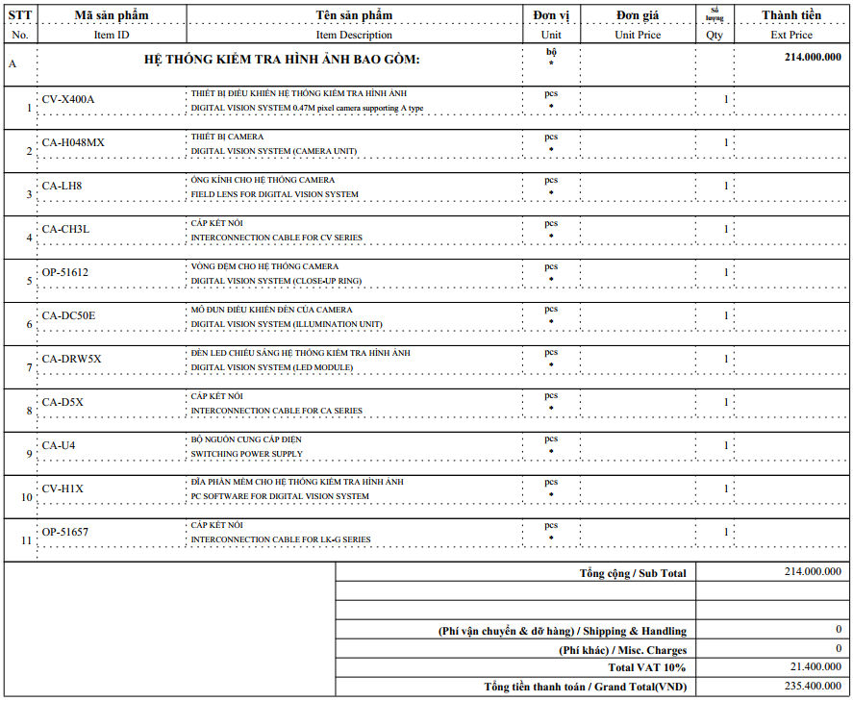
Benefits - Calculation on devices cost of project
The price make by ourself
Price make by outside supplier
The price for each package
Item |  | Qty | Price | Total
PC Set |  | 1 |  | $ 1,873.20
Intel Xeon E3-1225 v6 (Quad Core 3.3GHz, 3.7Ghz Turbo, 8MB, w/ HD Graphics P630). |  | 1
32GB (2X16GB) 2400MHz DDR4 UDIMM Non-ECC. |  | 1
1TB 3.5inch SATA (7,200 Rpm) HD. |  | 1
NVIDIA Quadro K620 2GB (DP, DL-DVI-I) (1 DP to SL-DVI adapter). |  | 1
Dell Wired Mouse MS116 Black. |  | 1
Dell Wired Keyboard KB216 Black EN. |  | 1
Windows 10 Pro for Workstations (up to 4 Cores) English. |  | 1
3Yr ProSupport:Next Business Day Onsite Service. |  | 1
I/O Controller |  |  |  | $ 982.80
Ethernet 750-342 | 500304605 | 1 | $ 764.40
4Ways input 750-403 | 500304675 | 1 | $ 78.00
4ways output 750-504 | 500304676 | 1 | $ 93.60
End Bus 750-60 | 500304616 | 1 | $ 46.80
Webcam logitech C310 |  | 1 |  | $ 30.65
Hall Effect Sensor |  | 1 |  | $ 100.00
Tower Alarm Light | 500367103 | 1 |  | $ 63.27
Adaptor 24VDC/1A |  | 1 |  | $ 148.00
Adaptor 12VDC/1A |  | 1 |  | $ 148.00
Hardware design |  | 1 |  | $ 36.52
Cover |  | 1 | 18.26
Camera Box |  | 1 | 18.26
Other |  |  |  | $ 100.00
LED lighting
Cable
Total |  |  |  | $ 3,482.44
$10,131.02
By apply this project obviously we can avoid cost about $6,648.58 on each saw tool.

Slide 16
Conclusion
Rootcause has been identified since the old method is totally depending on human.
By using a state-of-the-art deep-learning object detection we did build a system to detect and recognize the tray ID automatically on each input tray.
By applying the automatic detect tray method we would avoid loading wrong tray from the human mistake. Therefore, it can estimate save $52,272.00 each year.
In additional, the new system that we develop have has an ability to easily scallable and customize to any module using the same form factor of Intel tray.
The origin idea and contribution has lead by SAW AE-ME in VNAT site.

Slide 17
7. FUTURE PLAN
In depth studies to develop a fansatic function is detecting OOP unit on tray at SAW and it will be integrated into this improvement.
Introduce this method to across Module e.t MHS or all module that using tray
Introduce the new method of visual inspection for supplier.
Implemented this method across globally.

Slide 19
BACKUP

Slide 20
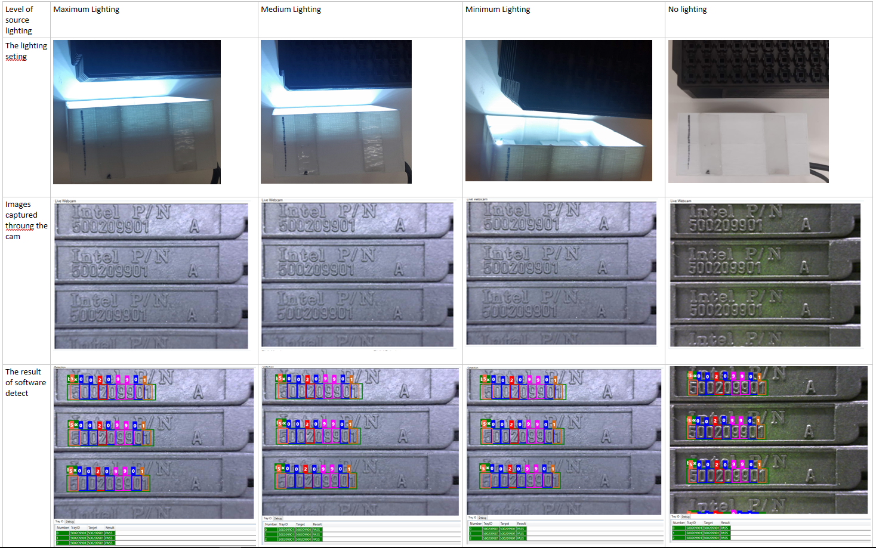
Testing the lighting and contrast auto adjustment function of webcam (1)

Slide 21
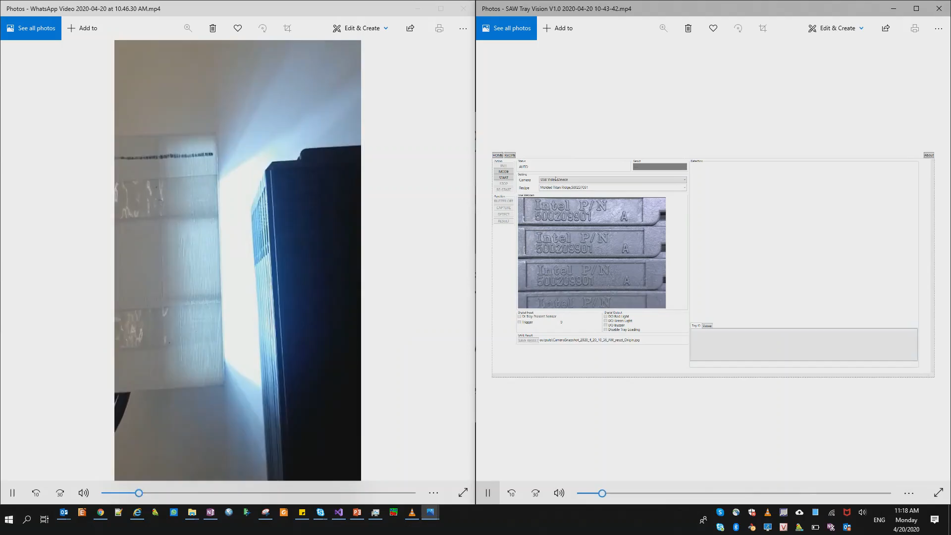
Testing the lighting and contrast auto adjustment function of webcam (2)
The left videos capture the actual camera kits that show the lighting is adjusted between max and min level.
The right vides capture the output tray image on the software.
Synchronization with boths videos is showed that when the lighting level at left change between max to min then the output image right side have auto-balanced the lighting and contrast.

